Slide 1

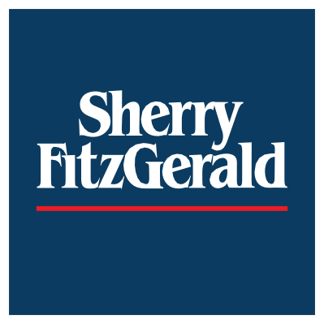
Sherry FitzGerald
Gender Pay Gap Report 2023

Slide 2
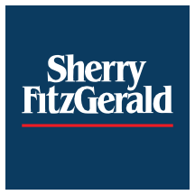

Sherry FitzGerald Group – Gender Breakdown
3
Gender Pay Gap 2023
39%
61%
Female Male

Slide 3
Initial findings
5
Gender Pay Gap 2023
A comprehensive analysis was carried out across the business from the 1st of July 2022 to the 30th June 2023.
The report is based on the hourly rates of pay and bonus pay between men and women.
Our data shows that there is a 29% mean gap (in comparison to a 30% mean gap in 2022) and a 30% median gap in hourly remuneration (in comparison to a 28% median gap in 2022) .
Following this exercise, we are clear that our pay gap arises as a result of a greater proportion of males in senior positions in specific areas of the business.
We are satisfied that we have pay parity for men and women in comparable roles. Employees are paid on a salary band applicable to their role.

Slide 4




Quartiles
In quartile 1 we have a representation of 54% men and 46% women
In quartile 2 we have a representation of 40 % men and 60% women.
In quartiles 3 and 4 our data shows a higher representation of women than men. (72% women and 28% men quartile 3 and 67% women and 33% male in quartile 4)
The percentage of male and female employees in each quartile pay and band

Slide 5


Bonus Gender Pay Gap
Percentage of male and female employee that received bonus remuneration
Gap
Mean 3%
Median 14%
% In receipt of Bonus
Regarding bonus renumeration 53% of males are in receipt of bonus compared to 47% of women. The mean bonus gap is 3% while on a median basis the gap is 14%.
Male
53%
Female
47%

Slide 6
Actions to date to address the Gender Pay Gap
8
Gender Pay Gap 2023
We are passionate about attracting and retaining the very best people and as such, are constantly reviewing our HR policies and people strategies. As a company we are committed and strongly support the narrowing of any gender pay gap and as such will promote current best practices and company objectives as listed below.
Recruitment process – reviewed and updated job advertisements and job titles to represent gender neutral language.
Reviewed gender balance in relation to our promotion process with full transparency in the selection process.
Continue to Champion the flexible working culture for men and women across our business.
Continue to promote a framework of gender balance as part of future succession planning and career progression particularly in the upper quartile of senior positions.
Raised awareness of all our family policies which equally support all genders.
Ongoing industry benchmarking to support pay transparency within the organisation.
Introduced initiatives to champion Diversity and Inclusion through our People, Value and Culture committees as part of our ongoing people plan.
While challenges and obstacles exist, we are committed to creating parity across all genders in the workplace and create a better culture for gender balance, transparency, and equality.

